Slide 1
MOCKTAIL-BASED MULTI-VIEW COBOL PROGRAM SUMMARIZATION USING BUSINESS RULES AND MULTI-AGENT LLMS
Presented by
CS24M111 - Gajula Kavyasri
CS24M121 - Kodela Phanindra
Under the guidance of
Dr. Sridhar Chimalakonda

Slide 2
Table of Contents
Introduction
Problem Definition
Literature Survey
Methodology
Pipeline
Implementation
Results
Conclusion
Future Work
References

Slide 3
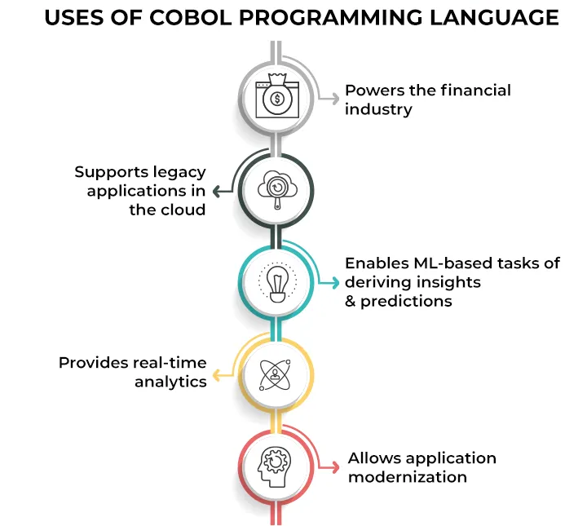
Introduction
Common Business-Oriented Language (COBOL) still powers 70%+ of global financial, government, and banking systems.
Legacy COBOL programs are hard to understand due to poor documentation and scattered, deeply embedded business logic.
Retiring COBOL experts and large monolithic codebases make manual understanding slow and error-prone.
Business rules in cobol plays an important role in understanding business logic and helps in code summarization tasks semantically.
Structural representations (AST, CFG, DFG, PDG) and business-rule tools (A-COBREX, COMEX) help reveal hidden program logic.
Recent LLM advances show that combining structural views with business rules enables more accurate COBOL program summarization.

Slide 4
Objectives
1. Generation of Multi-Source Code Representations.
2. Business Rule Extraction and Rule-Level Slicing.
3. Construction of Mocktail Representations.
4. Employing Multi-Agent LLMs for file-level explanations.
5. Evaluation Using Human-Annotated References by LLM-as-Judge.

Slide 5
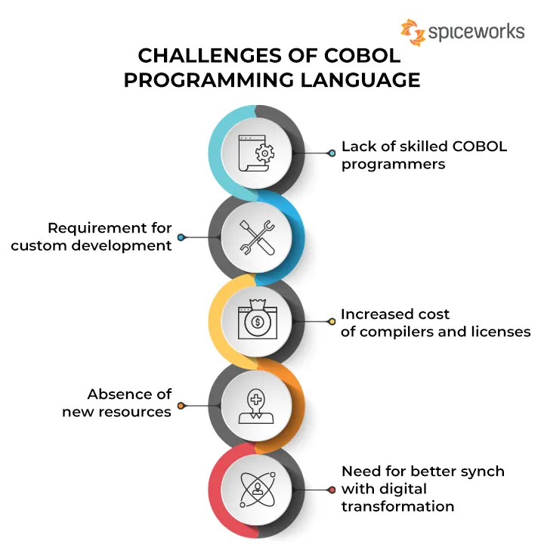
Problem Definition
Legacy COBOL programs contain deeply embedded business rules spread across paragraphs, nested conditions, and data flows, making them hard to understand.
Existing tools fail due to structural inconsistencies, dialect variations, copybooks, and large monolithic flows → leading to incomplete rule extraction.
Current LLM approaches struggle with long COBOL files and lack awareness of structural context and rule semantics.
There is no unified pipeline combining business-rule extraction, structural code representations (AST/CFG/DFG/PDG), and LLM reasoning for accurate summarization.
A systematic approach is required to extract rule-level semantics, integrate multi-view representations, and generate reliable COBOL summaries for modernization.
Core Problem – How do we automatically understand and summarize large COBOL programs using modern AI techniques?

Slide 6
Literature Survey
S.No | Paper | Venue | Core Idea | Key Strength | Limitation
1 | COBREX | ICSME 2022 | Extracts business-rule slices from COBOL | Helps modernization by exposing rule logic | Single-variable rules; incomplete slices
2 | A-COBREX | ICSE 2025 | RBB→BRR business rule reconstruction | Produces coherent and richer business rules | No cross-file/system-level rule extraction
3 | COMEX | ASE 2023 | AST/CFG/DFG extraction via tree-sitter | Extensible structural extraction | Not built for COBOL; grammar adaptation needed
4 | A Mocktail of Source Code Representations | ASE 2021 | Multi-view code representations (AST+CFG+PDG) | Boosts model performance on code tasks | Only evaluated on C; not for COBOL
5 | Multi-Agent COBOL Explanations | arXiv 2025 | Code Agent + Text Agent summaries | Better clarity & completeness | Small dataset; depends on LLM quality
6 | X-COBOL Dataset | arXiv 2023 | 84 COBOL repos curated with metadata | Largest public COBOL dataset | Contains noisy/low-quality projects
Table - 1. Summary of Literature Survey

Slide 7
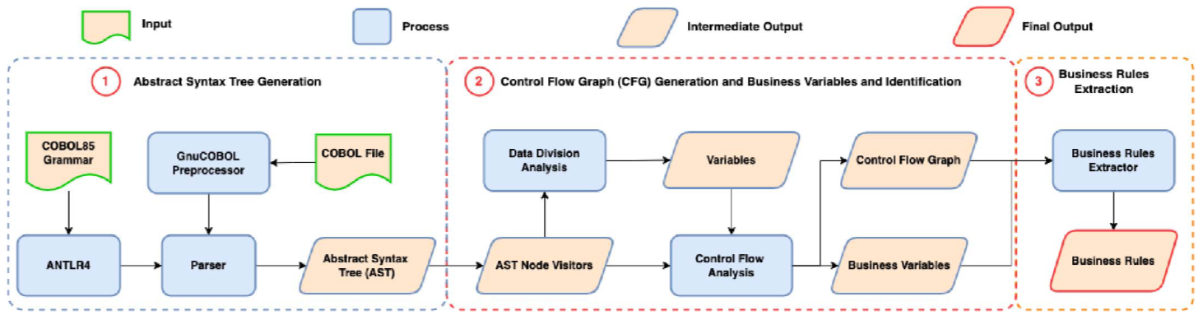
COBREX - A Tool for Extracting Business Rules from COBOL
Fig - 1. COBREX Architecture
Limitations:
Only single-variable rules
Fragmented
No BRR formation
Legacy COBOL parser
Variable-centric slices
Provides initial business rule fragments

Slide 8
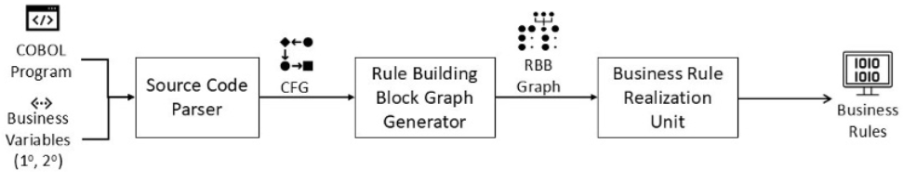
A-COBREX - A Tool for Identifying Business Rules in COBOL Programs
Fig - 2. A-COBREX Architecture
Extends COBREX
Builds BRR (Business Rule Realizations)
Produces structured, coherent business rules
Uses:
Control dependencies
Variable sharing
Multi-variable grouping

Slide 9
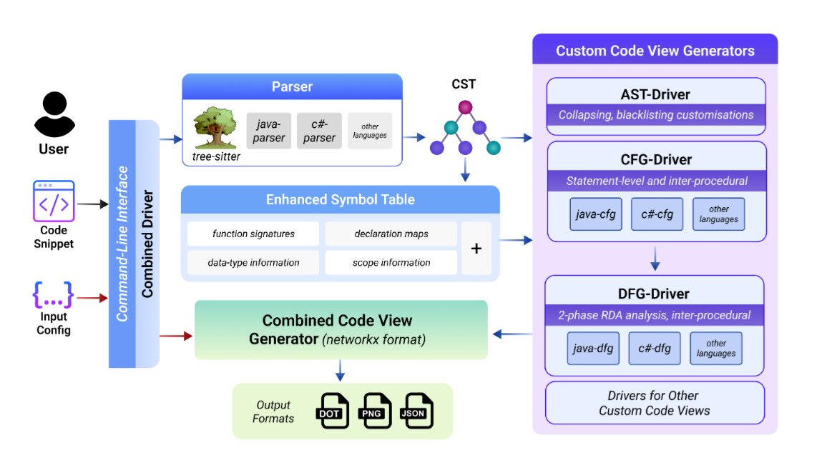
COMEX - Customized Source Code Representations
Fig - 3. COMEX Architecture
It extracts AST, CFG, and DFG to capture the program’s structure, control flow, and data movement, helping understand loops, branches, and key semantic patterns.

Slide 10
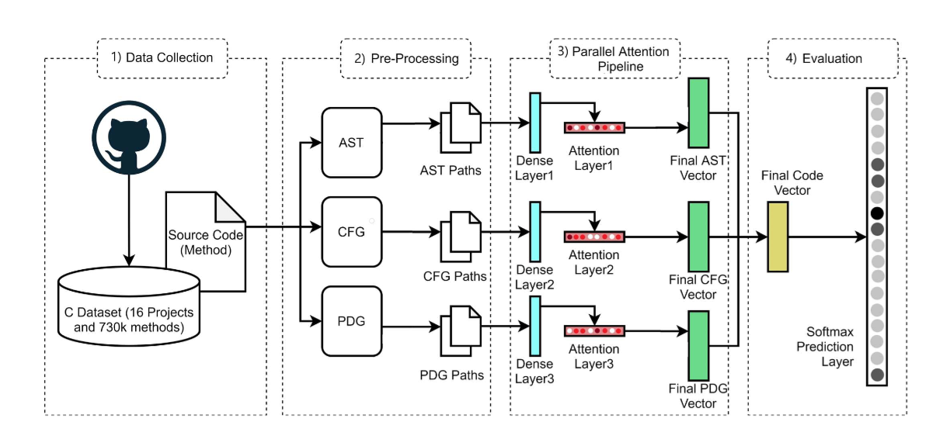
A Mocktail of Source Code Representations
Fig - 4. Mocktail Architecture
Mocktail mixes different code representations (AST, CFG, PDG) to capture complementary program features for C language.

Slide 11
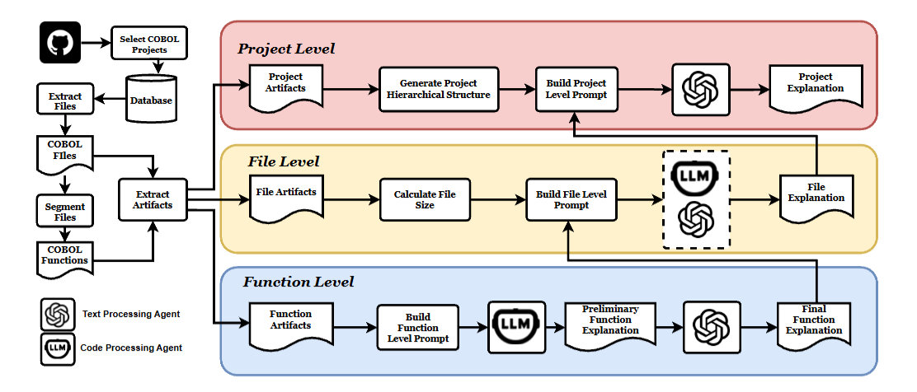
Enhancing COBOL Code Explanations with Multi-Agents Using Large Language Models
Fig - 5. Multi-Agent Architecture
Introduces a multi-agent system in which a Code Agent summarizes each COBOL function and a Text Agent combines them into a complete file explanation and then to project level explanations.

Slide 12
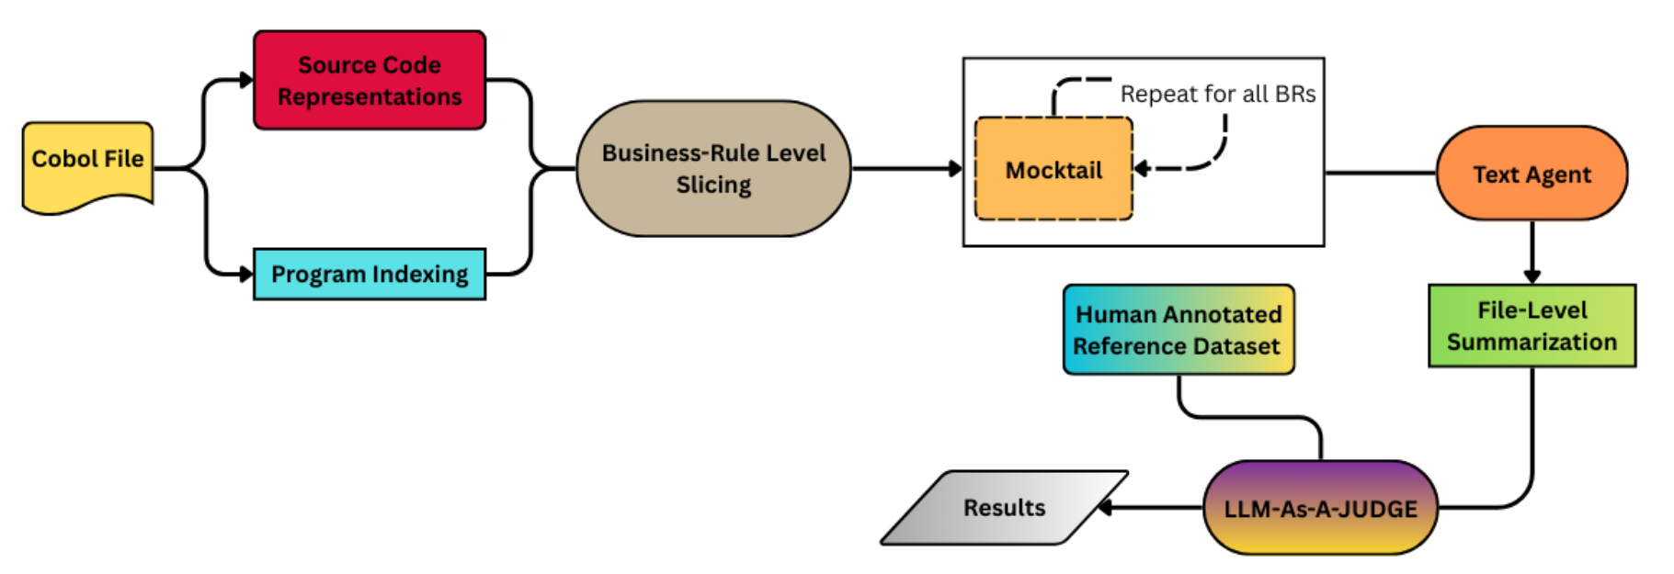
Overall Pipeline Architecture
Fig - 6. Pipeline
Here generation of Source code representations and Mocktail blocks are explained in detail in Fig- 7 and 15.

Slide 13
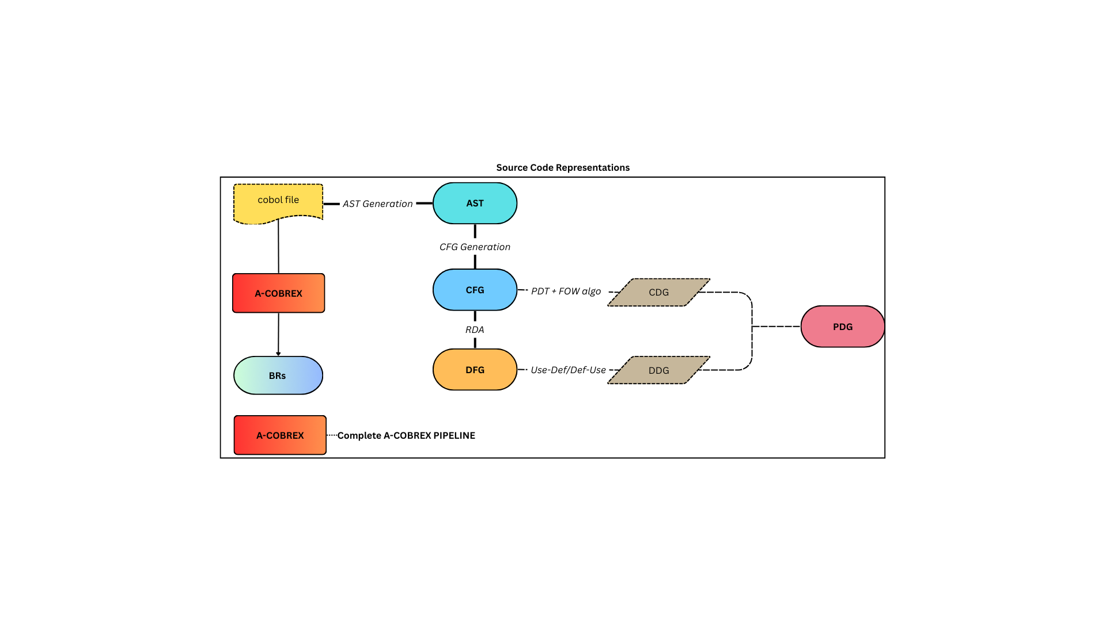
Generation of different Source Code representations
AST (Abstract Syntax Tree)
Tree structure showing the syntactic structure of the COBOL program.
Captures statements, expressions, and hierarchy of code blocks.
CFG (Control Flow Graph)
Directed graph showing execution order of statements.
Nodes = statements; Edges = control flow between blocks.
RDA (Reaching Definition Analysis)
Data-flow analysis to track which variable definitions reach which program points.
Basis for computing data dependencies.
DFG (Data Flow Graph)
Graph showing how data moves between statements.
Nodes = operations; Edges = def–use or use–def relationships.
Fig - 7. Source Code Representations

Slide 14
Generation of different Source Code representations (cont.)
CDG (Control Dependence Graph)
Shows how execution of one statement depends on a condition.
Derived from CFG using PDT and FOW algorithms.
DDG (Data Dependence Graph)
Shows data dependencies (one variable affecting another).
Built from RDA and def-use chains.
PDG (Program Dependence Graph)
Combines CDG + DDG into one unified graph.
Represents complete control + data dependencies of a program.
BRs (Business Rules)
Extracted logical conditions and actions describing business behavior encoded in COBOL.
Generated by A-COBREX from RBB → BRR merging.

Slide 15
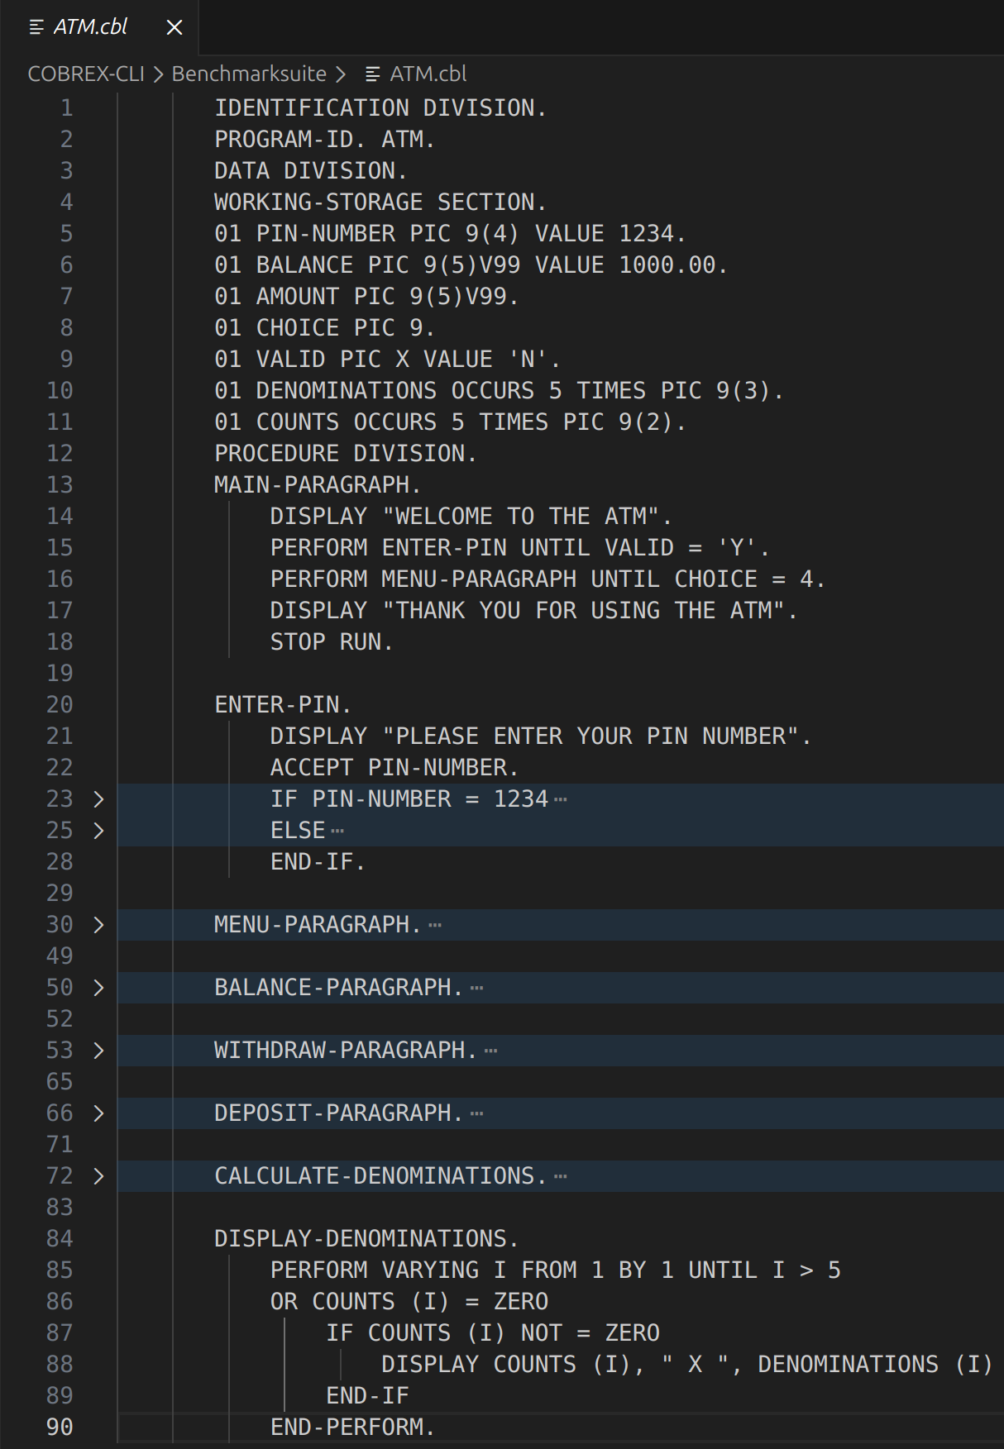
Implementation - Running Example
Fig - 8. Sample Source Code File

Slide 16
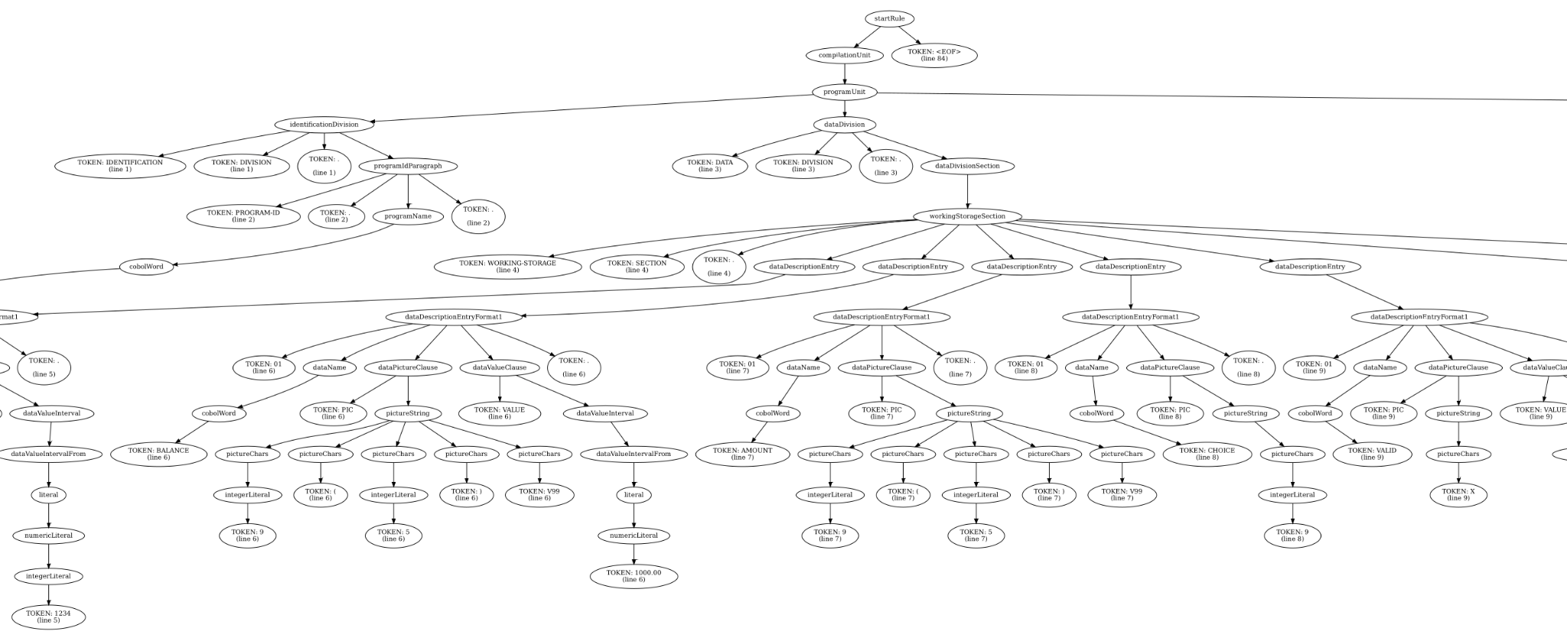
Generation of Abstract Syntax Tree (AST)
Fig- 9. A slice of AST of the Sample source code file

Slide 17
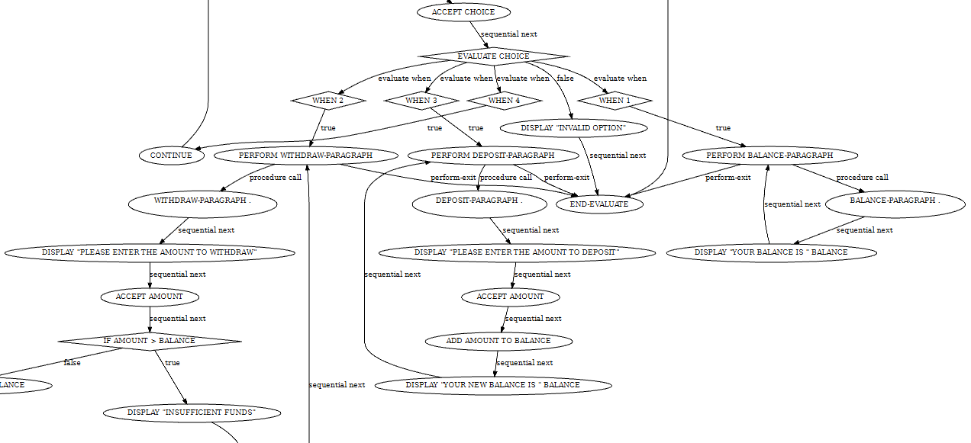
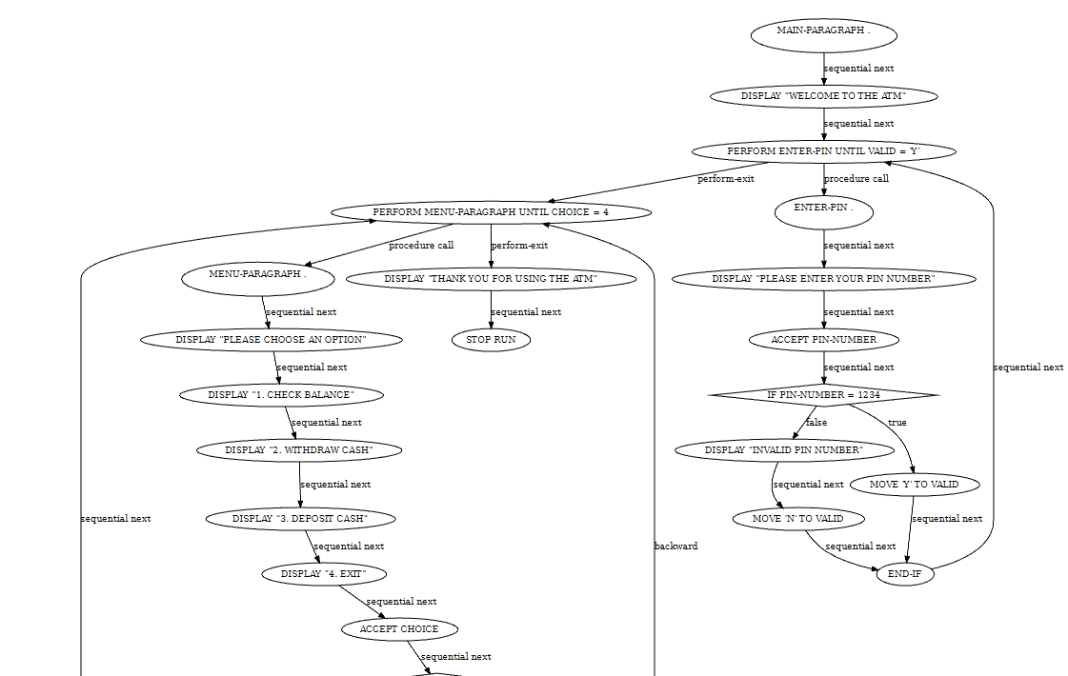
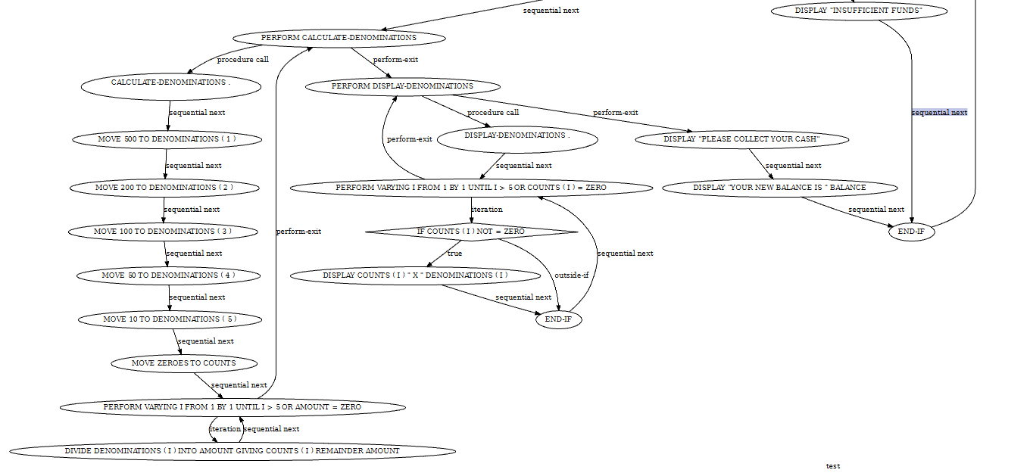
2. Generation of Control Flow Graph (CFG)
Fig- 10.2. Intermediate slice of CFG
Fig- 10.1. First slice of CFG of the Sample source code file
Fig- 10.3. Final slice of CFG

Slide 18
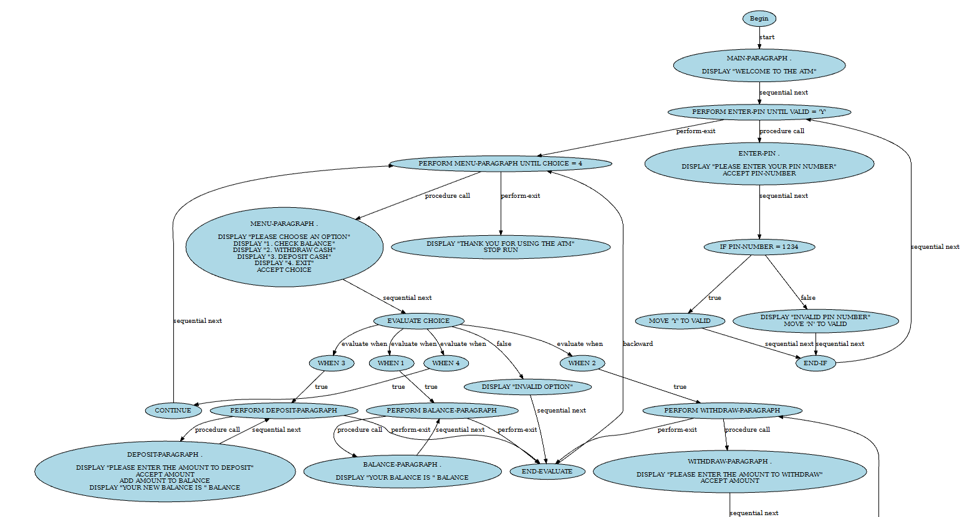
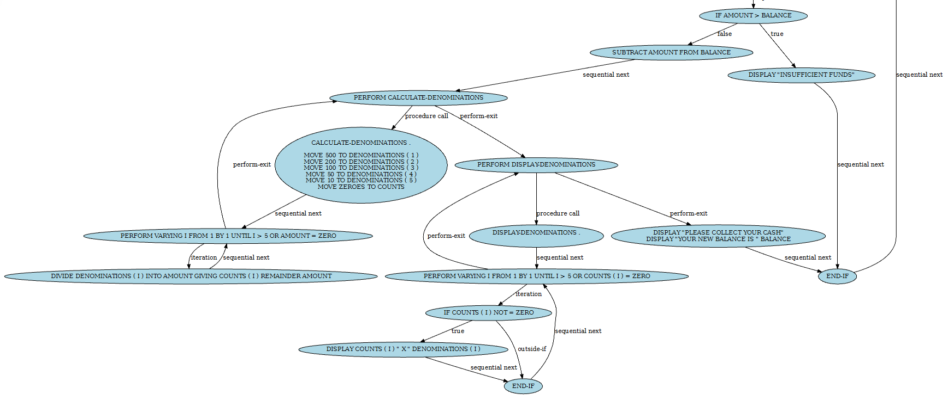
3. Generation of Rule Building Block Graph (RBB)
Fig- 11.1. First slice of RBB
Fig- 11.2. Last slice of RBB

Slide 19
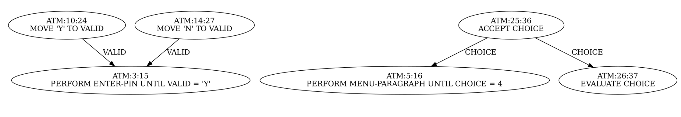
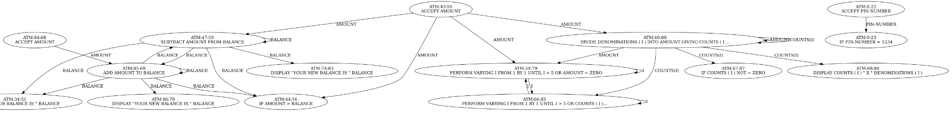
4. Generation of Data Flow Graph (DFG)
Fig- 12.1. A slice of DFG
Fig- 12.2. Next slice of DFG

Slide 20
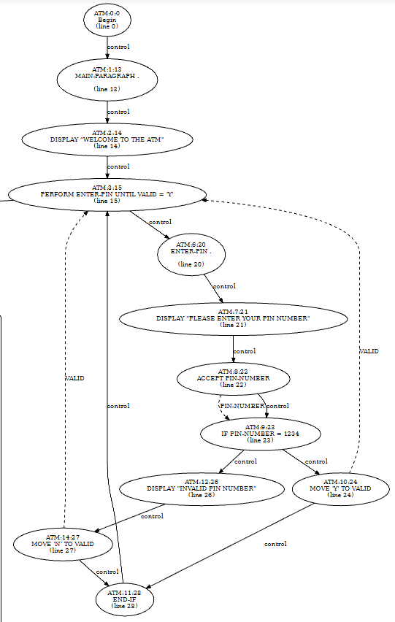
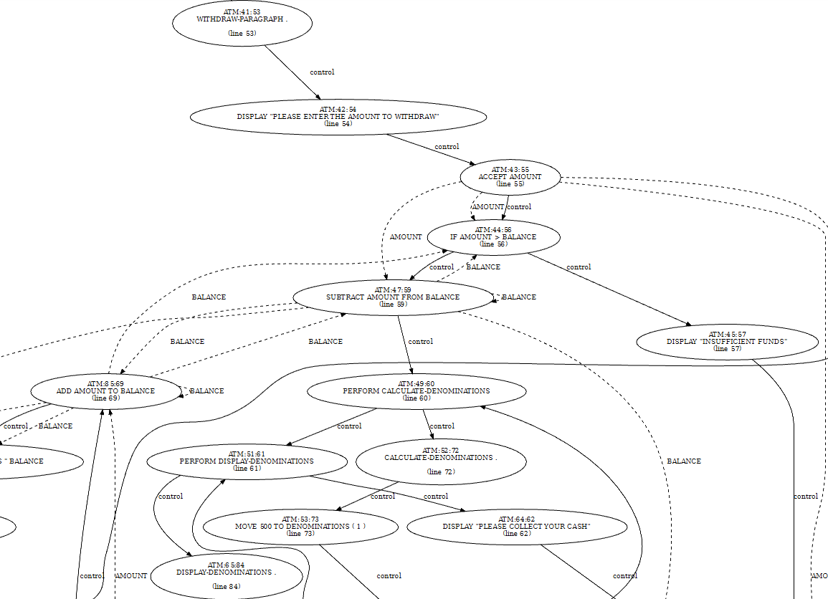
5. Generation of Program Dependency Graph (PDG)
Fig- 13.2. Next slice of PDG
Fig- 13.1. A slice of PDG

Slide 21
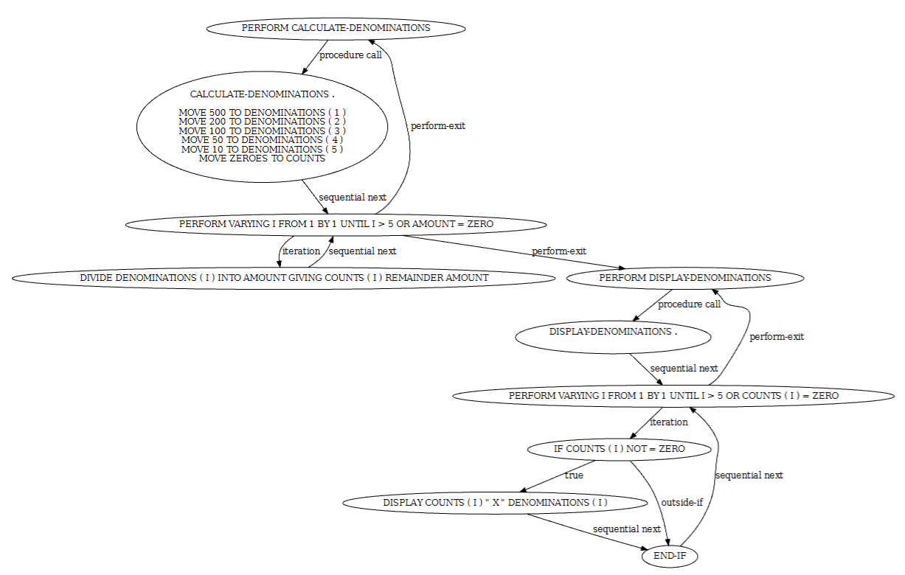
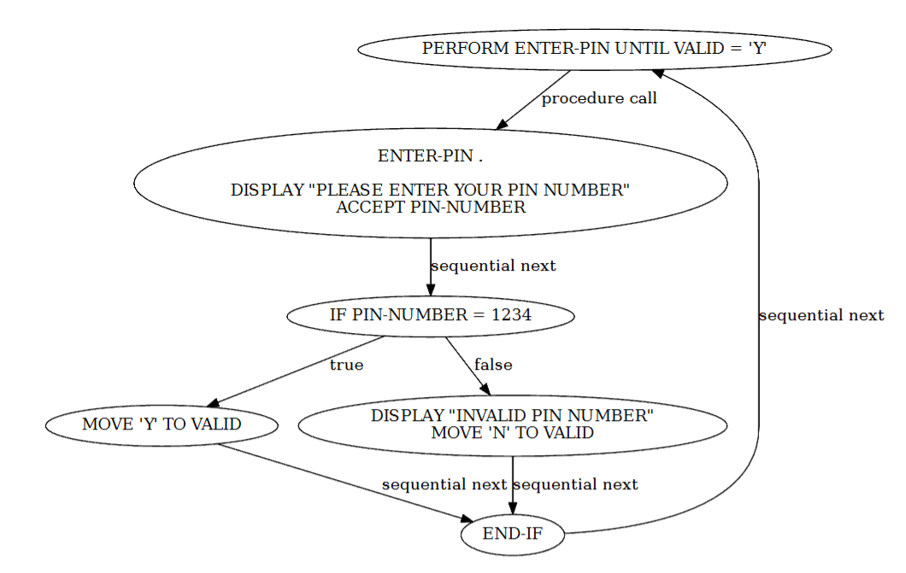
6. Extraction of Business Rules
Fig- 14.1. Rule-1
Fig- 14.2. Rule-2

Slide 22
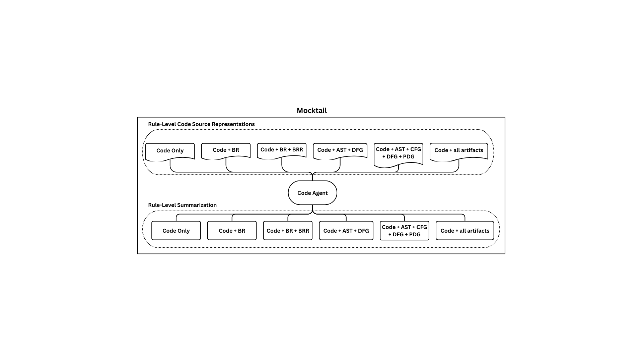
7. Mocktail of Multi-Style Code Representations
Code Agent: CodeLlama summarizes each BR slice independently using multi-view mocktails.
Text Agent: Llama 3.1 merges BR summaries into a coherent full-program explanation.
Fig- 15. Mocktail

Slide 23
8. Comparison
The COBOL program "ATM" is designed to facilitate ATM transactions for users. The program consists of two main rule units that handle different aspects of the ATM system. The first rule unit focuses on the process of entering a PIN number to access ATM services. It ensures that the user enters a valid PIN (1234) before proceeding to the main menu for transactions. This rule unit manages the loop for entering the PIN, displays messages for invalid entries, and updates the VALID flag accordingly. Once a valid PIN is entered, the user gains access to the ATM services without being locked out for multiple incorrect attempts.
The second rule unit in the program deals with calculating the denominations of currency required to fulfill a cash withdrawal or deposit transaction. This unit initializes the currency notes, divides the input amount by these denominations to determine the required count of each denomination, and displays this information to the user. It updates the account balance, keeps track of the remaining amount after dispensing denominations, and notifies the user of the new balance post-transaction. The code also sets up the denominations and updates the necessary variables for the transaction to be completed successfully.
Overall, the program ensures a secure and efficient ATM experience for users by verifying PIN entries and managing currency transactions accurately. It maintains consistency between the business rules and the COBOL code, emphasizing the importance of validating PINs and handling currency denominations effectively. The interaction between these rule units controls the flow of the ATM system, guiding users through the necessary steps for safe and reliable transactions.
This COBOL program simulates a simple ATM for a single account. It starts by welcoming the user and repeatedly asking for a PIN until the correct value (`1234`) is entered, using a flag (`VALID`) to track whether access is granted. If the PIN is wrong, it shows “INVALID PIN NUMBER” and forces another attempt. After successful login, the program displays a menu in a loop, allowing the user to check balance, withdraw cash, deposit cash, or exit.
For balance, it simply prints the current balance. For deposits, it reads an amount, adds it to the balance, and shows the updated balance. For withdrawals, it first checks if the requested amount exceeds the balance; if so, it prints “INSUFFICIENT FUNDS”. Otherwise, it subtracts the amount, splits it into standard note denominations (500, 200, 100, 50, 10) using loops, displays how many notes of each type are used, and then shows the new balance.
Generated File Summary
Reference File Summary

Slide 24
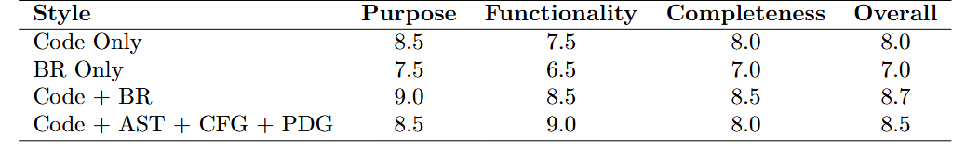
9. Evaluation
Scale (0.0-10)
Table 2: Evaluation Scores for ATM Cobol file (LLM-as-Judge)
Purpose - Measures how well the summary captures the main intent of the COBOL program or business rule.
Functionality - Evaluates how accurately the summary describes the program’s logical behavior and operations.
Completeness - Checks whether the summary covers all important conditions, rules, and key program actions.

Slide 25
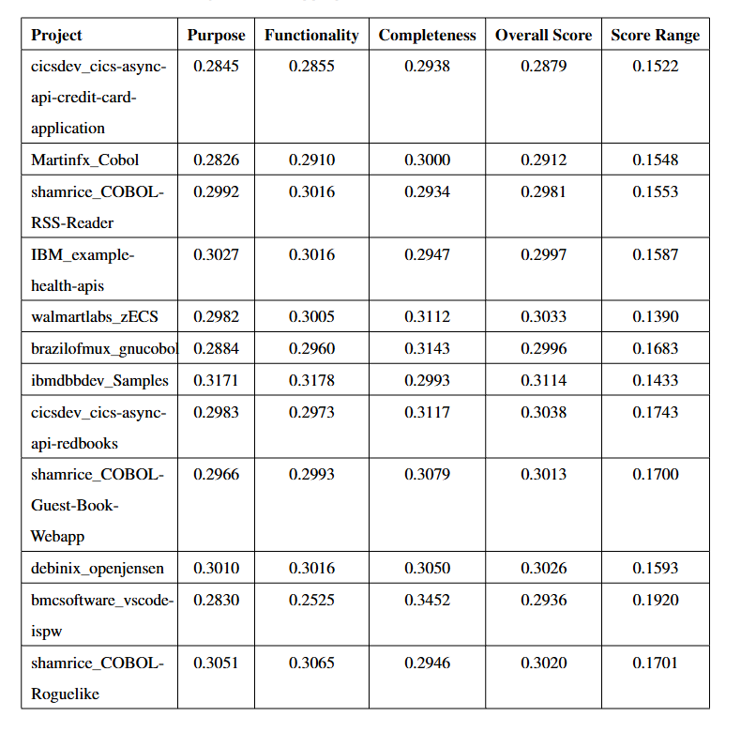
Results - Aggregate Scores
Scale (0.0-1.0)
Table-3: Project-level Aggregate Scores Across All Mocktail Modes

Slide 26
Results
Mocktail-based representations outperform code-only prompts, producing more accurate and semantically complete summaries.
BR + BRR–integrated mocktails achieve the highest evaluation scores, especially in completeness and functional correctness.
Multi-agent pipeline (rule-level + file-level) improves clarity compared to single-agent summarization.
File-level evaluation across 14 projects shows consistent gains in purpose and functionality metrics.
Project-level evaluation demonstrates stable performance across diverse COBOL codebases, confirming generalizability.
Comparison with the COBOL multi-agent baseline (2025) shows significant improvement in handling complex, multi-paragraph logic.

Slide 27
Limitations Based on Obtained Results
Limitations
Parser failures on SQL/CICS, copybooks, and COBOL dialect variations
A-COBREX constraints lead to incomplete BRR extraction
Mocktail failures when any structural graph (AST/CFG/DFG/PDG) is missing
No cross-file or system-level business-rule merging
Multi-agent LLM has no global context memory
Dataset filtering reduced total processed files
Evaluation depends mainly on LLM-as-Judge
Possible Improvements
Hybrid parsing with grammar repair + SQL/CICS normalization
Soft BRR merging and partial rule extraction
Interprocedural rule extraction & copybook linking
Add a Memory Agent to preserve file-level context
Expand dataset + auto-generate missing comments
Combine human + metric-based evaluation
Build COBOL-specific representations & domain ontologies

Slide 28
Conclusion
Business-rule–centric understanding is essential for interpreting legacy COBOL systems.
A-COBREX–based BRR extraction provides the right semantic granularity for summarization.
Multi-source structural views (AST, CFG, DFG, PDG) significantly enrich semantic accuracy.
Mocktail combinations—especially those integrating BR + BRR + structural graphs—produce far better summaries than code-only prompting.
The two-agent LLM architecture improves clarity by separating rule-level reasoning from file-level synthesis.
Overall, the framework establishes a strong foundation for automated COBOL comprehension and modernization support.

Slide 29
Future Work
Improve tolerant parsing to handle embedded SQL, CICS commands, and copybooks more reliably.
Enhance BRR reconstruction for complex multi-variable business rules and cross-program flows.
Integrate retrieval-augmented LLMs or COBOL-specific ontologies for more accurate summaries.
Extend mocktail representations to include data layouts, file I/O schemas, and domain metadata.
Explore cross-language coexistence of code representations—building a unified framework that aligns COBOL structures with modern languages (e.g., Java/Python) for modernization workflows.
Expand dataset, incorporate human-in-the-loop evaluation, and explore richer multi-agent strategies for robust summarization.

Slide 30
Contributions
Contributions of G. Kavyasri
Implemented mocktail construction modules and structural artifact processing (AST, CFG, DFG, PDG).
Assisted in rule-level slicing, representation formatting, and evaluation script creation.
Led dataset preprocessing, large-scale evaluation runs, and manual summary verification.
Contributions of K. Phanindra
Designed the overall methodology: multi-source representations + multi-agent workflow.
Implemented tolerant parsing, A-COBREX-based BRR logic, and evaluation pipeline integration.
Led dataset curation, project-level analysis, orchestration of artifacts, and major thesis writing.

Slide 31
References
Vagavolu, Dheeraj, Karthik Chandra Swarna, and Sridhar Chimalakonda. 2021. “A Mocktail of Source Code Representations.” In Proceedings of the 36th IEEE/ACM International Conference on Automated Software Engineering (ASE), 1296–1300.
Ali, Mir Sameed, Nikhil Manjunath, and Sridhar Chimalakonda. 2022. “COBREX: Extracting Business Rules from COBOL.” In 2022 IEEE International Conference on Software Maintenance and Evolution (ICSME), 273–278.
Ali, Mir Sameed, Nikhil Manjunath, and Sridhar Chimalakonda. 2023. “X-COBOL: A Dataset of COBOL Repositories.” arXiv preprint arXiv:2306.04892.
Das, Debeshee, Noble Saji Mathews, Alex Mathai, Srikanth Tamilselvam, Kranthi Sedamaki, Sridhar Chimalakonda, and Atul Kumar. 2023. “COMEX: Customized Source Code Representations.” In Proceedings of the 38th IEEE/ACM International Conference on Automated Software Engineering (ASE), 2054–2057.
Shah, Samveg, Shivali Agarwal, Saravanan Krishnan, Vini Kanvar, and Sridhar Chimalakonda. 2025. “A-COBREX: Identifying Business Rules in COBOL Programs.” In 2025 IEEE/ACM 47th International Conference on Software Engineering: Companion Proceedings (ICSE-Companion), 5–8.
Lei, Fangjian, Jiawen Liu, Shayan Noei, Ying Zou, Derek Truong, and William Alexander. 2025. “Enhancing COBOL Code Explanations with Multi-Agents Using Large Language Models.” arXiv preprint arXiv:2507.02182.
Github link - https://github.com/cs24m111/mtp-cobol-mocktail-summarization.git.

Slide 32
Thank you

